Slide 1

The while Loop
Keep Going Until It's Done!
Presented by: Amit Roy MSc student at IIT

Slide 2
What Exactly is while?
I was listening to music while doing my homework.
• Condition: doing my homework.
• Statement: I was listening to music

Slide 3
What Exactly is a while Loop?
• Think of it like waiting for a bus.
🚌🧍‍♂️
• Condition: 'I will wait as long as the bus hasn't arrived.'
• As long as condition is True (no bus) → you keep waiting (looping).
• When condition becomes False (bus arrives) → you stop waiting!

Slide 4
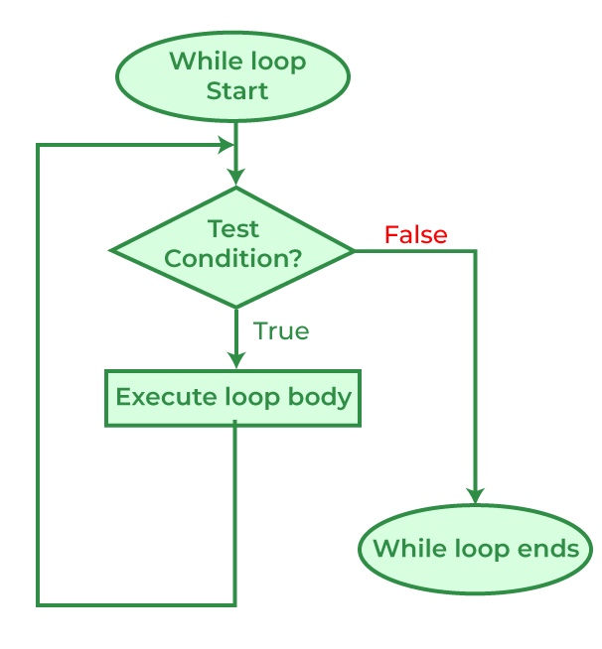
How the Computer Reads It
1. Check the condition.
2. If it's True, run the code inside.
3. Go back up and check again.
4. If it's False, skip the code and exit!
while condition:
# Some statement to be executed

Slide 5
The 3 Golden Rules! 🏆
Practice 5.1: Counting From 1 to 5
Every working while loop needs these 3 parts:
1
Initialize
Where do we start?
# 1. Initialize
2
Condition
count = 1
When do we stop?
# 2. Condition
3
Update
while count <= 5:
How do we move forward?
print(f"Count: {count}")
# 3. Update
count = count + 1

Slide 6
Fun Example: Countdown! 🚀
Problem 5.2: Let's launch a rocket by counting backward from 10. (10 to 1)
10
9
8
7
6
5
4
3
2
1
number = 10
🚀
print("Countdown:")
while number > 0:
print(number)
# Counting down!
number = number - 1
print("Blast off! 🚀")

Slide 7
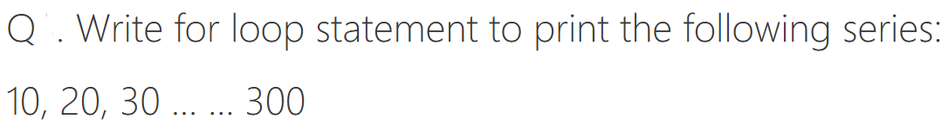
Class Task 1:

Slide 8
Class Task 1:
number = 10
while number <=300:
print(number)
# Counting down!
number = number + 10

Slide 9
When to use which loop?
for Loop
while Loop
When you know exactly how many times to repeat.
When you don't know how many times, just a condition.
VS
🏋️‍♂️
🚗⛽
"Lift the weight 10 times"
"Keep driving until fuel is empty."

Slide 10
For loop vs While loop
# Using for loop when you know the exact number of iterations
print("Using FOR loop - counting 1 to 5:")
for i in range(1, 6): # We know exactly 5 iterations
print(f"Number: {i}")
# Using while loop for the same task (less common for counting)
print("Using WHILE loop - counting 1 to 5:")
counter = 1 # Initialize
while counter <= 5: # Test condition
print(f"Number: {counter}") # Loop body
counter = counter + 1 # Update counter

Slide 11
Fun Example: Sum Calculator!
Problem 5.4: Calculate sum of the numbers until user enter 0

Slide 12
Fun Example: Sum Calculator!
Problem 5.4: Calculate sum of the numbers until user enter 0
total = 0
number = 1 # Initialized with 1 just to start the loop
print("Enter numbers to add (enter 0 to stop):")
while number != 0: # Condition: Stop the loop if user enters 0
number = int(input("Enter a number: "))
if number != 0: # Only add if the number is not 0
total = total + number
print(f"Running total: {total}")
print(f"Final sum: {total}")

Slide 13

DANGER: Infinite Loop
What happens if you forget Rule #3 (The Update)?
• The condition never becomes False.
🐹🔄
• The loop runs FOREVER.
• Your program crashes/hangs!
count = 1
while count <= 5:
RUNNING FOREVER...
print(count)
# MISSING: count = count + 1
# Prints forever! ☠️

Slide 14
DANGER: Infinite Loop
Common Mistake
Forgetting to update the control variable
Updating in the wrong direction (decreasing when you should increase)
Using the wrong comparison operator in the condition

Slide 15


Loop Control: Rules Breakers
break
continue
The Emergency Exit.
The Skip Button.
Stops the loop completely, no matter what the condition is, and jumps out.
Skips the rest of the current round and jumps right back to the top condition check.

Slide 16
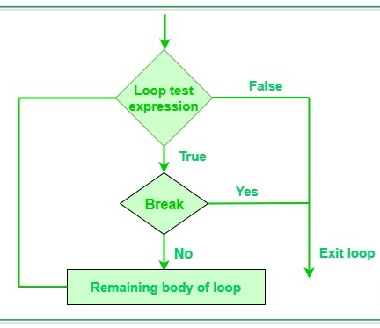
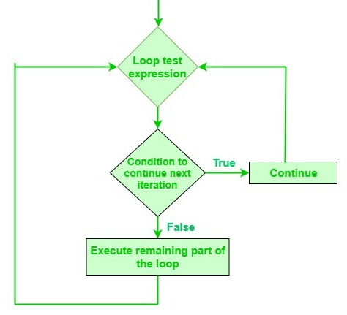
Loop Control: Rules Breakers
break
continue

Slide 17
Loop Control: Rules Breakers
break
continue
count = 1
while count <= 5:
if count == 3:
break # loop stop here
print(count)
count += 1
count = 0
while count < 5:
count += 1
if count == 3:
continue # 3 skip
print(count)

Slide 18

Real-Life: Password Checker 🔐
5.8 A common use: force a user to enter valid information. It will keep asking until correct!
correct_pwd = "python123"
user_pwd = ""
* * * * *
while user_pwd != correct_pwd:
user_pwd = input("Enter password: ")
if user_pwd != correct_pwd:
print("Wrong! Try again.")
print("Access granted! 🔓")

Slide 19

Any Questions?
Thank you for listening!

Slide 20
Let’s Practice
1. Simple Countdown
Write a program that asks the user for a starting number and counts down to 1, printing each number.
2. Even Number Counter
Use a while loop to print all even numbers from 2 to 20.
3. Positive Number Sum
Keep asking the user for positive numbers and add them to a total. Stop when they enter -1 and display the final sum.

Slide 21
Let’s Practice
4. Number Guessing Game
Pick a secret number (like 7). Keep asking the user to guess until they get it right. Tell them "Too high" or "Too low" for wrong guesses.
5. Multiplication Practice
Ask the user to solve multiplication problems (like 3 x 4). Keep giving new problems until they get one wrong. Count how many they got right.
6. Power Calculator
Ask for a base number. Use a while loop to calculate and print its powers (base, base, base, etc.) until the result exceeds 1000.

